Slide 1
The Bad Boyz

Slide 2
Solving a Word Search
Design and Analysis of Algorithms for
Created in collaboration with students such as:
Chase
Ryan
John
And Austin

Slide 3

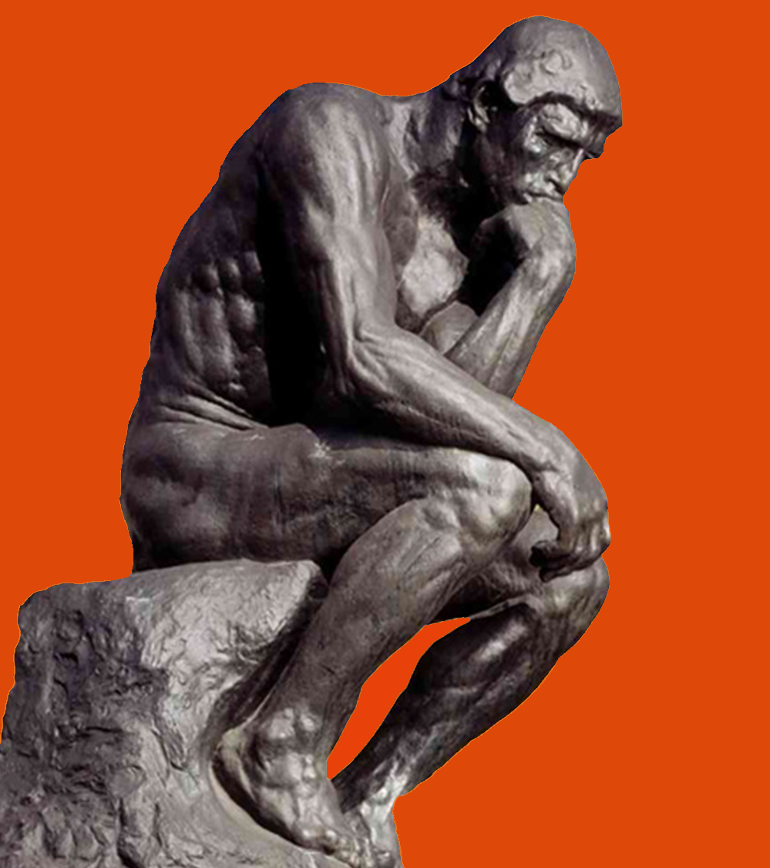
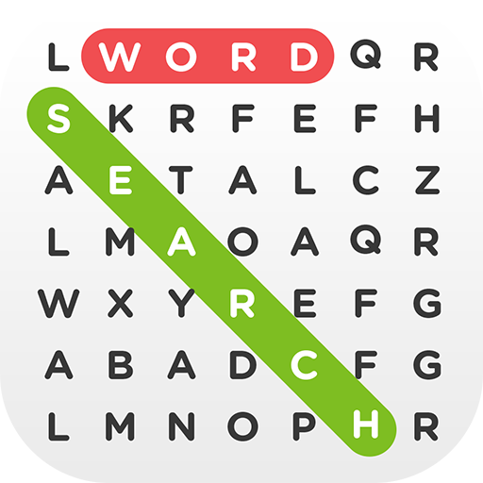
Our Problem
In Natural Language:
Find all words in a given word list within a board of randomly generated characters
Aka a Word Search Puzzle

Slide 4
Formal Statement: Variables
B_{r, c} = matrix of letters comprising game board, r & c indicate position
H = Length of a row/column of the Board (B)
L = List of words to find: [w₁, w₂, w₃, … w_{i-1}]
I = number of words
w = word in word list: [e₁,e₂,e₃,…e_{m-1})
m=number of characters (e) in word
S = sequence of characters for any w ϵ L
N = number of characters in a sequence
D = list of directions: [(-Y), (+Y), (+X), (-X), (-Y,-X), (-Y,+X), (+Y,-X), (+Y,+X)]

Slide 5
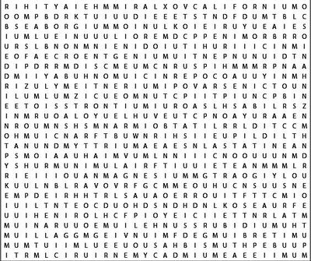
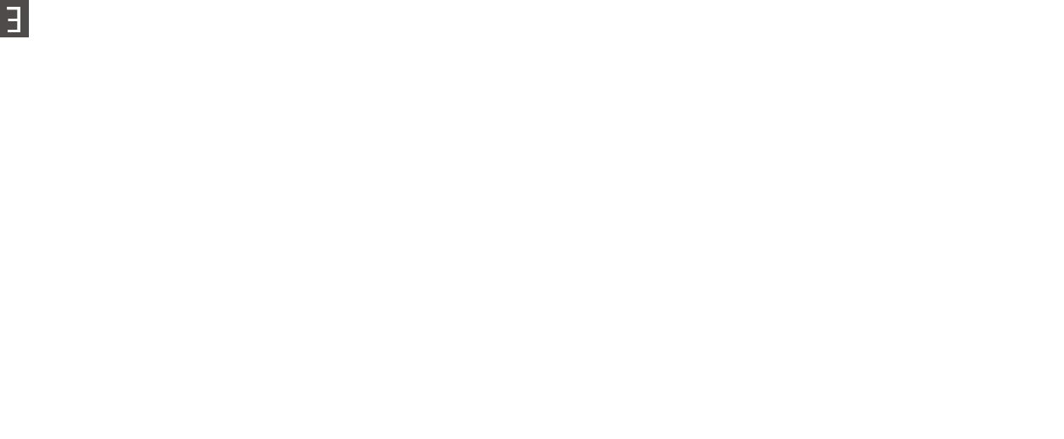
Formal Statement
“For all words W in word list L such that the first character in Word W_{k} exist in Board B at some given coordinate (r,c)…
Alabama
Alaska
Arizona
Arkansas
California
Colorado Connecticut
{
AND
B
The sequence S_{k} of word w_{k} is equal to sequence S_{o} where S_{o} is all combinations of sequences around B_{r, c}”
L
If this statement returns true, the word w_{k} exist at B_{r,c} in direction D
{∀ w ϵ L | (w_{k}[0] B_{r, c}) ∩ (S_{k} = B_{r, c} + (S_{k}-S_{k}[0]) ∀ D_{e} ϵ D | N_{k} = M_{k})} = T/F

Slide 6

Analyzation of the Algorithms
We will have 4 different test
Base Case
Change Board size
Change average word size
Change word list size
The testing consisted of…
10 trials
3 Puzzles
i.e. BaseCase_RunTime $=\frac{\text{(}\text{(}\sum_{n=1}^{10}{\text{P}\text{1}}_RunTime \text{)+ (}\sum_{n=1}^{10}{\text{P}\text{2} }_RunTime \text{)+(}\sum_{n=1}^{10}{\text{P}\text{3}}_RunTime \text{)}\text{)}}{30}$
 | Board Size | Avg Word Size | Word List Size | Iterations
Base Case | 50x50 | 8.18 | 50 | 5000
Δ Board Size | 100x100 | 8.18 | 50 | 5000
Δ Avg Word Size | 50x50 | 4.0 | 50 | 5000
Δ Word List Size | 50x50 | 8.18 | 25 | 5000
*Avg Word Size uses a different word list (randomly generated 4 letter words)

Slide 7
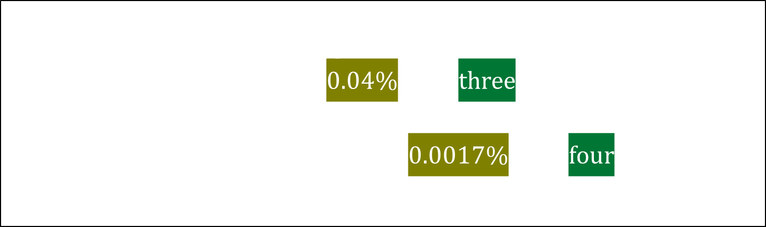
Why Using 4 Letter Words is Viable
When using shorter words in our tests, we considered the fact that shorter words have a greater chance of appearing randomly on a large board.
Since the likelihood of a four letter word appearing randomly in a 50 by 50 word search is less than a hundredth of a percent, we considered it statistically negligible in the context of our research.
$$50×50=2,500 → \frac{2500}{26}≈96.15 → \frac{96.15}{2500}=0.03846$$
$0.0384×\frac{8}{26}×\frac{1}{26}=0.0004$ or 0.04% for a three letter word
$0.0384×\frac{8}{26}×\frac{1}{26}×\frac{1}{26} =$ 0.000017 or 0.0017% for a four letter word

Slide 8
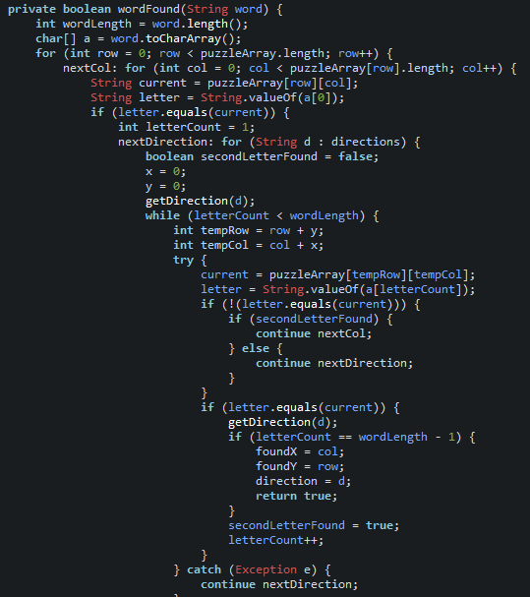
Brute Force
Brute Force checks every possible spot for each word until it is found.
This is obtained naively by using nested loops, giving it a time complexity of O(H²*m*i)
Where….
H = the width/length of the board
i = length of word list
m = number of characters in word w_{i}
The base case test complete on average in
5.284

Slide 9
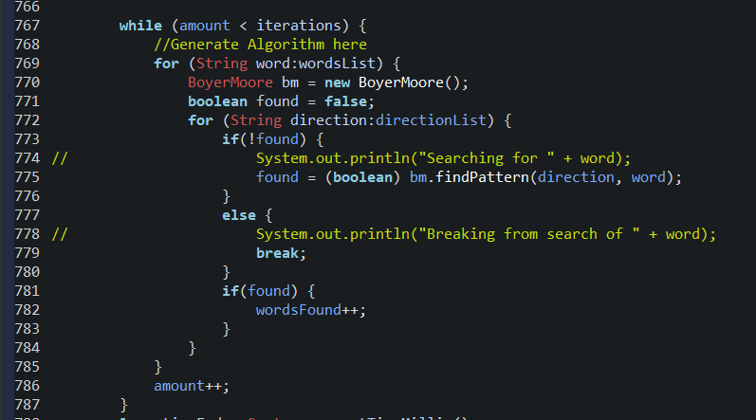
Boyer-Moore
The Boyer-Moore Method relies heavily on pre-processing and converting everything to strings to search for words.
Preprocessing = O(H²*D) ← letters in board times number of directions
Boyer Moore = O(i*D*H²*m) ←# words * # directions*characters in board*characters in word
Total = O(H²*D + i*D*H²*m)
The base case test complete on average in
14.931 with preprocessing
2.543 without preprocessing
*Real life use: control + F (find in your browser)
H = Length of a row/column of the Board (B)
L = List of words to find: [w₁, w₂, w₃, … w_{i-1}]
I = number of words
w = word in word list: [e₁,e₂,e₃,…e_{m-1})

Slide 10
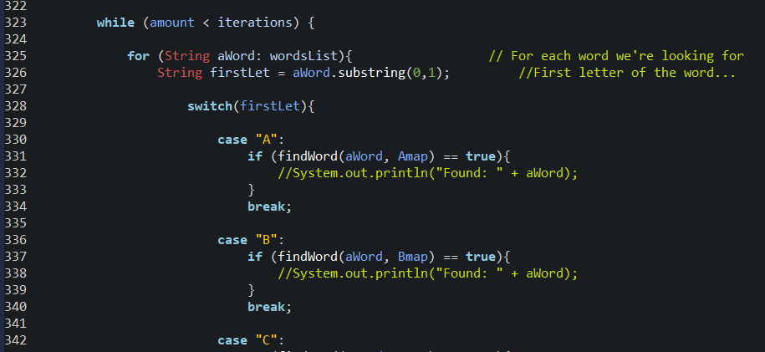
Bear Method
The Bear Method also relies heavily on pre-processing, since it sorts all letters in the board into 26 hash maps based on their letter.
This algorithm employs 4 loops, giving it a time complexity of O(H²*m*i*G)
Where….
H = the width/length of the board
m = number of characters in word w_{i}
i = length of word list
G = length of HashMap
[Dimensions of the board squared, times the length of the word list, times the length of the current word]
The base case test complete on average in
10.52
H = Length of a row/column of the Board (B)
L = List of words to find: [w₁, w₂, w₃, … w_{i-1}]
I = number of words
w = word in word list: [e₁,e₂,e₃,…e_{m-1})

Slide 11
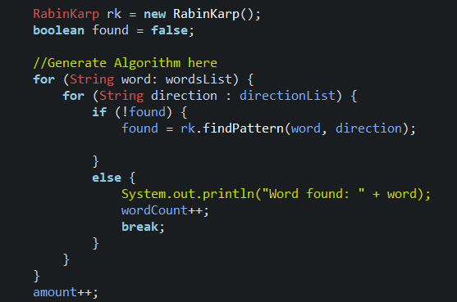
Rabin-Karp
The Rabin-Karp method also relies on pre-processing and converting the board to a string, but in addition, it also uses hash maps.
Uses same preprocessing as Boyer Moore.
Preprocessing = O(H²*D) ← letters in board times number of directions
Rabin-Karp= O(i*D*H²*c) ←# words * # directions*characters in board*characters in word
Total complexity= O(H²*D + i*D*H²*c)
The base case test complete on average in
13.252 with preprocessing
1.071 without preprocessing
*Real life use: plagiarism
H = Length of a row/column of the Board (B)
L = List of words to find: [w₁, w₂, w₃, … w_{i-1}]
I = number of words
w = word in word list: [e₁,e₂,e₃,…e_{m-1})

Slide 12
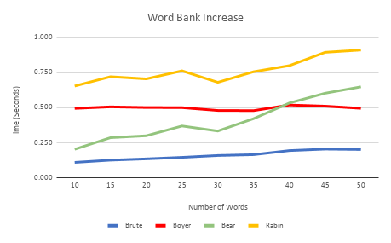
Change In Number of Words
Boyer-Moore and Brute Force stay relatively steady as the number of words increase.
The Bear Method and Rabin-Karp algorithms runtimes increase much faster as the word list grows.

Slide 13
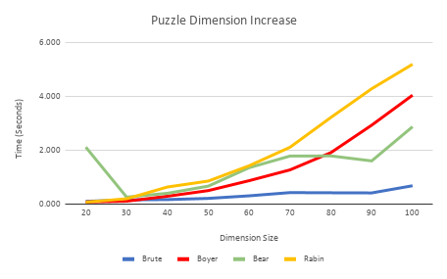
Change Board Size
Increasing the board size was the constraint that increased runtimes the most.
All algorithms exhibit exponential growth except the Brute Force algorithm which shows more linear growth.

Slide 14
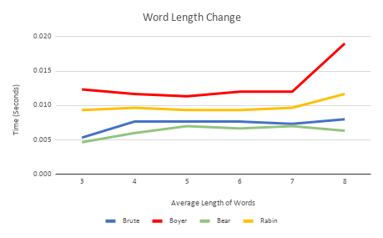
Change In Length of Words
The length of words had little to no affect on the time it took until it got back to an average length of 8 letters per word.
This makes sense considering no matter how long your word is, if you’ve found the first three letters of the word in the right order, [on a 50x50 board] there’s approximately a 99.96% chance you have found your word.
I.E Cat is virtually as easy to find as Indianapolis

Slide 15
All 4 Time Complexities and Run Times
 | Time Complexities | Base Case Run Time | Δ Board Size Run Time | Δ Avg. Word Size Run Time | Δ Word List Size Run Time
Brute Force | O(H²*L*w) | 5.284 | 29.034 | 5.143 | 4.506
Bear | O(H²*L*w) | 10.52 | 64.254 | 0.026 | 12.452
Boyer-Moore | O(H²*L*n) | 14.931 | 161.518 | 18.236 | 15.121
Boyer-Moore* | O(H²*L) | 2.543 | 12.616 | 6.263 | 3.295
Rabin-Karp | O(H²*L*n) | 13.252 | 152.030 | 13.121 | 13.058
Rabin-Karp* | O(H²*L) | 3.071 | 13.350 | 7.070 | 4.324
* - indicates without preprocessing the data

Slide 16
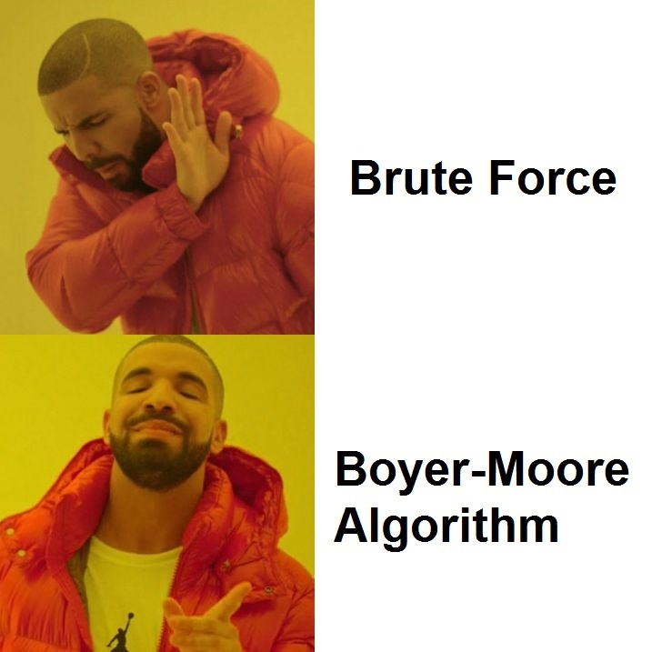
Original Hypothesis
We predict…
Boyer-Moore will be the most efficient algorithm when dealing with a larger data set.
That when changing the constraints to our problem, the performance of each algorithm will be affected.

Slide 17
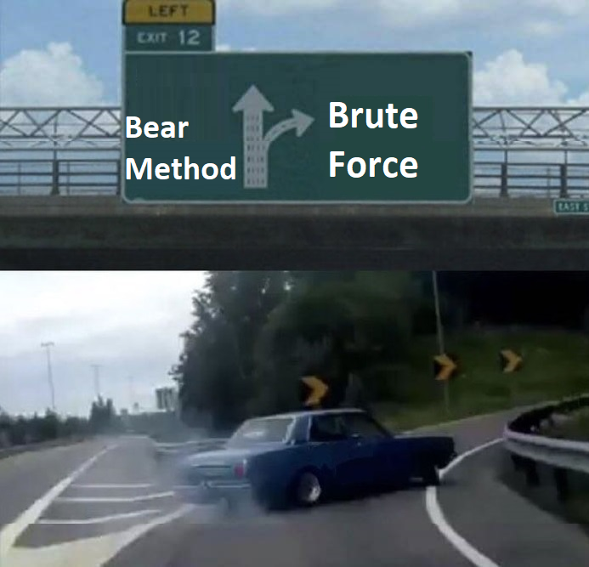
Conclusion
Interesting findings…
Most naïve implementation was the most efficient
Also had the greatest time complexity
Preprocessing data had significant impact on Boyer and Rabin algorithms
String searching algorithms (Boyer and Rabin) preformed poorly
Rabin could lose accuracy when increasing board size
Bear method performed worse than Brute Force
Possible Improvements…
Change constraints multiple times

Slide 18
Questions…
What are the 3 constraints for a word search puzzle?
Average Word Size
Word List Size
Board Size
What are some real-world applications for Boyer-Moore and/or Rabin-Karp?
Boyer-Moore: Using CTRL + F to find words on a web page
Rabin-Karp: Checking for plagiarism
Is a Word search Puzzle a Constraint Satisfaction or Optimization problem?
CSP
Why aren’t string algorithms ideal for a word search problem?
Converting the puzzle to a string causes the algorithm to search through way more letters due to the possibility of words going different directions outweighing any benefits
Why is Boyer-Moore faster than Rabin-Karp given the same time complexity?
Rabin-Karp stops at each character in the search and then compares word to pattern where Boyer-Moore’s benefit is skipping unnecessary characters.

Slide 19

Questions?

